Slide 1
Chapter 14
E-Commerce Strategy
and Global EC

Slide 2
Learning Objectives
Describe the strategic planning process.
Describe the purpose and content of a business plan.
Understand how e-commerce impacts the strategic planning process.
Understand how to formulate, justify, and prioritize EC applications.

Slide 3
Learning Objectives
Describe strategy implementation and assessment, including the use of metrics.
Evaluate the issues involved in global EC.
Analyze the impact of EC on small and medium-sized businesses.

Slide 4
Organizational Strategy:
Concepts and Overview
strategy
A broad-based formula for how a business is going to accomplish its mission, what its goals should be, and what plans and policies will be needed to carry out those goals

Slide 5
Organizational Strategy:
Concepts and Overview
Strategy and the Web Environment
  e-commerce strategy (e-strategy)
  The formulation and execution of a vision of how a new or existing company intends to do business electronically

Slide 6
Organizational Strategy:
Concepts and Overview
Strategy and the Web Environment
  strategic information systems planning (SISP)
  A process for developing a strategy and plans for aligning information systems (including e-commerce applications) with the business strategies of an organization

Slide 7
Organizational Strategy:
Concepts and Overview
The Strategic Planning Process
  Strategy initiation
  Strategy formulation
  Strategy implementation
  Strategy assessment

Slide 8
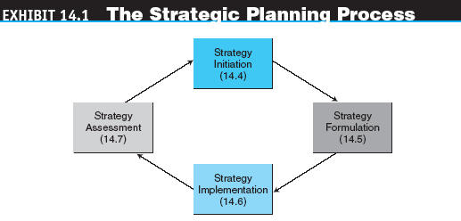
Organizational Strategy:
Concepts and Overview

Slide 9
Organizational Strategy:
Concepts and Overview
strategy initiation
The initial phase of strategic planning in which the organization examines itself and its environment

Slide 10
Organizational Strategy:
Concepts and Overview
Specific outcomes initiation phase include:
  Company analysis and value proposition
    value proposition
    The benefit that a company’s products or services provide to a company and its customers
  Core competencies
  Forecasts
  Competitor (industry) analysis

Slide 11
Organizational Strategy:
Concepts and Overview
strategy formulation
The development of strategies to exploit opportunities and manage threats in the business environment in light of corporate strengths and weaknesses

Slide 12
Organizational Strategy:
Concepts and Overview
Specific activities and outcomes from the formulation phase include:
  Business opportunities
  Cost-benefit analysis
  Risk analysis, assessment, and management
  Business plan

Slide 13
Organizational Strategy:
Concepts and Overview
strategy implementation
The development of detailed, short-term plans for carrying out the projects agreed on in strategy formulation

Slide 14
Organizational Strategy:
Concepts and Overview
Specific activities and outcomes from the strategy implementation phase include:
  Project planning
  Resource allocation
  Project management

Slide 15
Organizational Strategy:
Concepts and Overview
strategy assessment
The continuous evaluation of progress toward the organization’s strategic goals, resulting in corrective action and, if necessary, strategy reformulation

Slide 16
Organizational Strategy:
Concepts and Overview
Strategic Planning Tools
  SWOT analysis
  A methodology that surveys external opportunities and threats and relates them to internal strengths and weaknesses
  competitor analysis grid
  A strategic planning tool that highlights points of differentiation between competitors and the target firm

Slide 17
Organizational Strategy:
Concepts and Overview
  scenario planning
  A strategic planning methodology that generates plausible alternative futures to help decision makers identify actions that can be taken today to ensure success in the future
  balanced scorecard
  A management tool that assesses organizational progress toward strategic goals by measuring performance in a number of different areas

Slide 18
Business Planning in E-Commerce
business plan
A written document that identifies the company’s goals and outlines how the company intends to achieve those goals

Slide 19
Business Planning in E-Commerce
Outline of a business plan
  Executive Summary
  Business Description
  Operations Plan
  Financial Plan
  Marketing Plan
  Competitor Analysis

Slide 20
Business Planning in E-Commerce
Business Plan Fundamentals
  Purposes for business plan
    To acquire funding
    To acquire nonfinancial resources
    To obtain a realistic approach to the business
business case
A business plan for a new initiative or large, new project inside an existing organization

Slide 21
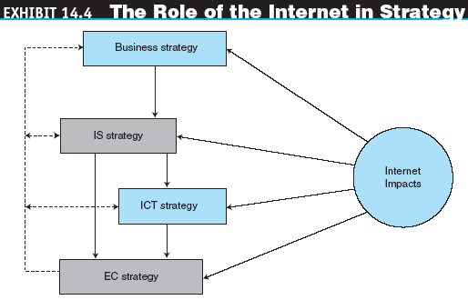
E-Business Strategy:
Concepts and Overview

Slide 22
E-Strategy Initiation
Issues in E-Strategy Initiation
  Be a First Mover or a Follower?
  Born-on-the-Net or Move-to-the-Net?
  Determining Scope
  Have a Separate Online Company?
  Have a Separate Online Brand?

Slide 23
E-Strategy Formulation
Selecting EC Opportunities
  Incorrect approaches to EC strategy selection:
    Indiscriminately funding many projects and hoping for a few winners
    Betting it all in a single, high-stakes initiative
    “Trend-surfing”
  Productive approaches to EC strategy selection
    Problem-driven strategy
    Technology-driven strategy
    Market-driven strategy
    E-business maturity model

Slide 24
E-Strategy Formulation
Determining an Appropriate EC Application Portfolio Mix
  The BCG model
  An Internet portfolio map for selecting applications

Slide 25
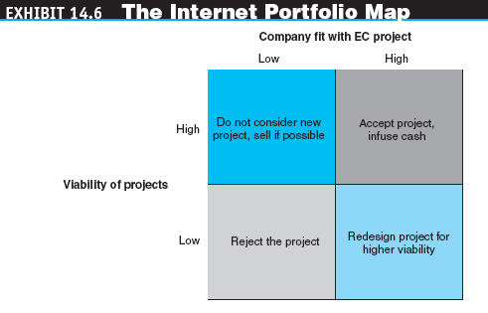
E-Strategy Formulation

Slide 26
E-Strategy Formulation
Risk Analysis and Management
  e-commerce (EC) risk
  The likelihood that a negative outcome will occur in the course of developing and operating an electronic commerce strategy
  Security issues

Slide 27
E-Strategy Formulation
Issues in Strategy Formulation
  How to handle channel conflict
  How to handle conflict between the off-line and online businesses
  Pricing strategy
    Price comparison is easier
    Buyers sometimes set the price
    Online and off-line goods are priced differently
    Differentiated pricing can be a pricing strategy
      versioning
      Selling the same good, but with different selection and delivery characteristics

Slide 28
E-Strategy Implementation
Create a Web Team
  project champion
  The person who ensures the EC project gets the time, attention, and resources required and defends the project from detractors at all times
Start with a Pilot Project
Allocate Resources
Manage the Project

Slide 29
E-Strategy Implementation
Strategy Implementation Issues
  Application development
  Partners’ strategy
    outsourcing
    The use of an external vendor to provide all or part of the products and services that could be provided internally

Slide 30
E-Strategy Implementation
Business alliances and virtual corporations
  virtual corporation (VC)
  An organization composed of several business partners sharing costs and resources for the production or utilization of a product or service
  co-opetition
  Two or more companies cooperate together on some activities for their mutual benefit, even while competing against each other in the marketplace

Slide 31
E-Strategy Implementation
  Redesigning business processes
    business process reengineering (BPR)
    A methodology for conducting a comprehensive redesign of an enterprise’s processes

Slide 32
E-Strategy Implementation
  business process management (BPM)
  Method for business restructuring that combines workflow systems and redesign methods; covers three process categories—people-to-people, systems-to-systems, and systems-to-people interactions

Slide 33
E-Strategy and Project Assessment
The Objectives of Assessment
  Measure the extent to which the EC strategy and ensuing projects are delivering what they were supposed to deliver
  Determine if the EC strategy and projects are still viable in the current environment
  Reassess the initial strategy in order to learn from mistakes and improve future planning
  Identify failing projects as soon as possible and determine why they failed

Slide 34
E-Strategy and Project Assessment
Measuring Results and Using Metrics
  metric
  A specific, measurable standard against which actual performance is compared
  corporate (business) performance management (CPM, BPM)
  Advanced performance measuring and analysis approach that embraces planning and strategy

Slide 35
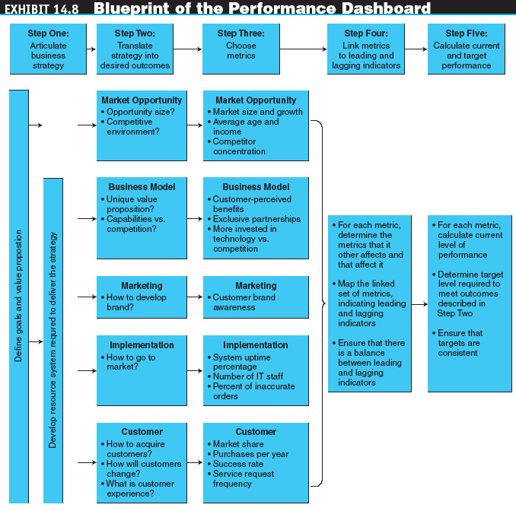
E-Strategy and Project Assessment

Slide 36
E-Strategy and Project Assessment
Web analytics
The analysis of clickstream data to understand visitor behavior on a Web site

Slide 37
Global E-Commerce
Benefits and Extent of Operations
  The major advantage of EC is the ability to do business at any time, from anywhere, and at a reasonable cost

Slide 38
Global E-Commerce
Barriers to Global EC
  Cultural issues
  Culture and language translation
  Administrative issues
  Geographic issues and localization
  Economic issues

Slide 39
Global E-Commerce
Breaking Down the Barriers to Global EC
  Be strategic
  Know your audience
  Localize
  Think globally, act consistently
  Value the human touch
  Clarify, document, explain
  Offer services that reduce barriers

Slide 40
E-Commerce in Small and Medium-Sized Enterprises
Advantages and Benefits of EC to Small and Medium-Sized Enterprises
  Inexpensive sources of information
  Inexpensive ways of advertising and conducting market research
  Competitor analysis is easier
  Inexpensive ways to build storefronts
  Less locked into legacy technologies
  Image and public recognition can be generated quickly
  An opportunity to reach worldwide customers

Slide 41
E-Commerce in Small and Medium-Sized Enterprises
Disadvantages and Risks of EC to Small and Medium-Sized Enterprises
  Lack of financial resources to fully exploit the Web
  Lack of technical staff or insufficient expertise in legal issues, advertising, etc.
  Less risk tolerance than a large company.
  Products not suitable for online sales
  Reduced personal contact with customers
  Inability to afford the advantages of digital exchanges

Slide 42
E-Commerce in Small and Medium-Sized Enterprises
Critical Success Factors for SMES
  Product is critical
  Payment methods must be flexible
  Electronic payments must be secure
  Capital investment should be kept to a minimum
  Inventory control is crucial
  Logistics services must be quick and reliable

Slide 43
E-Commerce in Small and Medium-Sized Enterprises
Critical Success Factors for SMES
  Owner support
  High visibility on the Internet
  Join an online community
  A Web site should provide all the services needed by consumers
Supporting SMES
  Government agencies
  Vendor service centers

Slide 44
Managerial Issues
What is the strategic value of EC to the organization?
Who determines EC strategy?
What are the benefits and risks of EC?
Why do we need a plan?
What metrics should we use?

Slide 45
Managerial Issues
What staffing is required?
How can we go global?
Should the dot-com activities be spun off as a separate company?
Can we learn to love smallness?
Is e-business always beneficial?

